Slide 1
PHP – An Introduction
Angana Chakraborty : ROLL:1
Priyanka Das :ROLL:5
Samarpita Mitra :ROLL:
Ranjita Mukherjee :ROLL:
----M.Sc Computer Science(sem-1)

Slide 2
PHP CONNECTING MYSQL
PHP MEANS HYPERTEXT PRE-PROCESSOR. PHP LANGUAGE HAS FULL SUPPORT FOR COMMUNICATING WITH MYSQL DATABASE. PHP IS A SERVER-SIDE SCRIPTING LANGUAGE, SIMILAR TO JAVA SCRIPT IN MANY WAYS AS THEY BOTH ALLOW TO EMBED LITTLE PROGRAMS(SCRIPTS) INTO THE HTML OF A WEB PAGE.
IN EXECUTING SUCH SCRIPTS ALLOW YOU TO CONTROL WHAT WILL ACTUALLY APPEAR IN THE BROWSER WINDOW IN SOME WAY MORE FLEXIBLE WHAT IS POSSIBLE USING STRAIGHT HTML.

Slide 3
Server-Side Scripting Language
RESPONSE
Server data is accessed
The HTML page is displayed here—no php execution is needede
Php scrist is run here—produces output html page
REQUEST

Slide 4
Retrieving the server’s time
Using the following code the receiver can see the time of server: as the php script is actually run in the server.
<html>
<body>
<?php
echo(strftime('%c'));
?>
</body>
</html>

Slide 5
WRITING IN PHP SCRIPTS
WE FIRST WRITE A SIMPLE PHP SCRIPT test.php:
<?php
echo “Hello World”;
?>
GO TO THE SHELL AND EXECUTE THE SCRIPT BY THE COMMAND:
php –f test.php
AND IT WILL PRINT: Hello world

Slide 6
Why is PHP used?
Cross Platform
Runs on almost any Web server on several operating systems.
One of the strongest features is the wide range of supported databases
Web Servers: Apache, Microsoft IIS, Caudium, Netscape Enterprise Server
Operating Systems: UNIX (HP-UX, OpenBSD, Solaris, Linux), Mac OSX, Windows NT/98/2000/XP/2003
Supported Databases: Adabas D, dBase,Empress, FilePro (read-only), Hyperwave, IBM DB2, Informix, Ingres, InterBase, FrontBase, mSQL, Direct MS-SQL, MySQL, ODBC, Oracle (OCI7 and OCI8), Ovrimos, PostgreSQL, SQLite, Solid, Sybase, Velocis, Unix dbm

Slide 7
Why is PHP used?
Cost Benefits
PHP is free. Open source code means that the entire PHP community will contribute towards bug fixes. There are several add-on technologies (libraries) for PHP that are also free.
 | PHP
Software | Free
Platform | Free (Linux)
Development Tools | Free PHP Coder, jEdit

Slide 8
COMMAND TO CONNECT PHP WITH MYSQL
To connect to the MYSQL we write the php script :
<?php
$d=mysql_connect(“localhost”,”username”,”password”);
if($d)
echo “connected”;
?>
This line tells PHP to connect to the MySQL database server at 'localhost' (localhost means the server that the site is running one).

Slide 9
SELECTING THE DATABASE
To select the database the command should be :
$d=mysql_select_db(“student”)
If($d)
echo
(“Database selected”);
else
echo(“Error”);
This tells PHP to select the database stored in the variable $database (which is set earlier). If it cannot connect it will stop executing the script and output the text.

Slide 10
EXECUTING COMMANDS
There are two ways of executing a command. One is to just enter the command in PHP. This way is used if there will be no results from the operation.
The other way is to define the command as a variable. This will set the variable with the results of the operation.
mysql_query($query);

Slide 11
CREATING TABLES
Suppose we have a database named ‘student’ and within it we will create a database named ‘result’
<html>
<body>
<p>
<?php
$d=mysql_connect("localhost","root","");
if($d)
echo(" connected");
mysql_select_db("student");
$sql="create table result(roll integer(3) primary key,name varchar(20),marks integer(4));";
$s=mysql_query($sql);
if($s)
echo(" table created");
?>
</p>
</body>
</html>

Slide 12
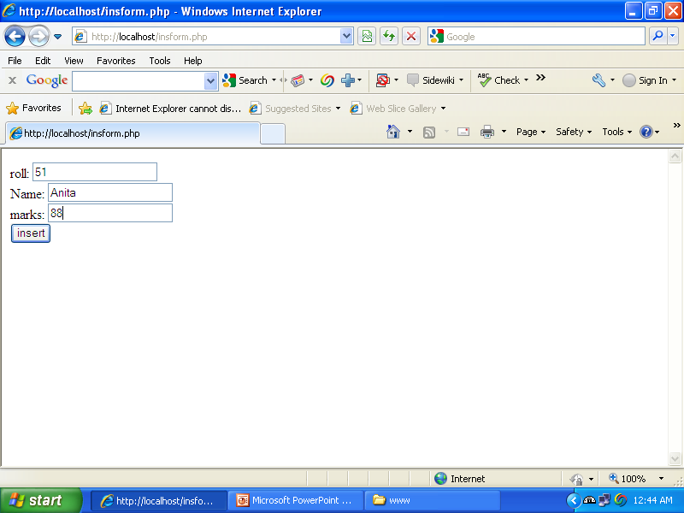
INSERTION USING FORM DESIGN

Slide 13
CREATING FORMS
TO CREATE THE FORMS FOR INSERTION WE HAVE TO WRITE THE FOLLOWING HTML CODE:
<html>
<body>
<form action="ins.php" method="post">
roll: <input type="text" name="roll" /><br />
Name: <input type="text" name="name" /><br />
marks: <input type="text" name="marks" /></br>
<input type="submit" value="insert" />
</form>
</body>
</html>
THIS IS A SCRIPT “insform.php” WHICH CREATES STUDENT’S RECORDS WITH THREE FIELDS NAME AND ROLL, AND MARKS.THE VALUES ARE INSERTED FOLLOWING THE METHOD WRITTEN IN A PHP SCRIPT NAMED “ins.php”.

Slide 14
INSERTING DATA
Suppose we have a database named ‘test’ which is set to the variable ‘$database’ and it has a table named ‘sample’. Then the command to insert data:
<?php
mysql_connect("localhost","root","");
mysql_select_db("student");
$sql="insert into result values('$_POST[roll]','$_POST[name]','$_POST[marks]')";
$q=mysql_query($sql);
if($q)
echo("one row inserted");
else
echo("error");
?>

Slide 15
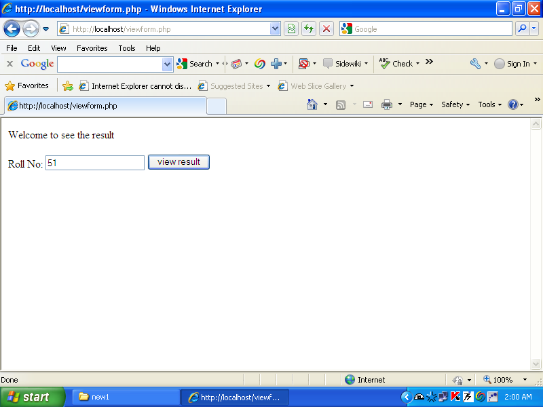
Form To Retrieve Data

Slide 16
Retrieval Form design
<html>
Welcome to see the result
<body>
<form action="view.php" method="post">
Roll No: <input type="text" name="roll" />
<input type="submit" value="view result" />
</body>
</html>

Slide 17
PHP script to retrieve data
<html>
<body>
The result is:<br />
<?php
mysql_connect("localhost","root","angana");
mysql_select_db("student");
$sql="select * from result where roll='$_POST[roll]';";
$val=mysql_query($sql);
$row=mysql_fetch_array($val);
echo("<p>ROLL: ". $row[roll]."</p><p> NAME: ".$row[name]."</p><p> MARKS: ".$row[marks]."</p>");
?>
</body>
</html>

Slide 18
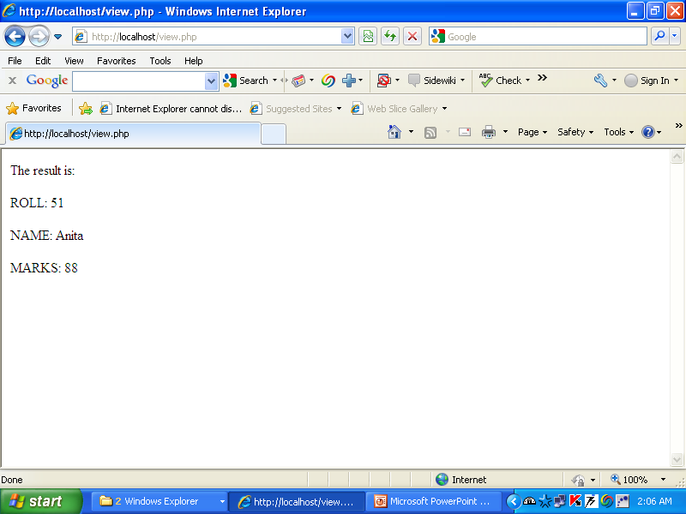
Display after retrieval

Slide 19
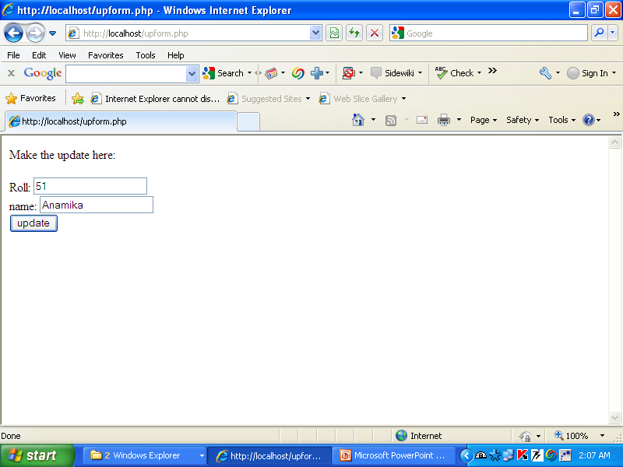
Form of updatation

Slide 20
Update Form Design
<html>
<body>
Make the update here:
<form action="up.php" method="post">
Roll: <input type="text" name="roll"><br />
name: <input type="text" name="name"><br />
<input type="submit" value="update">
</form>
</body>
</html>

Slide 21
PHP code to Update
<?php
mysql_connect("localhost","root","angana");
mysql_select_db("student");
$sql="update result set name='$_POST[name]' where roll='$_POST[roll]';";
$d=mysql_query($sql);
if($d)
echo("one row updated");
?>

Slide 22
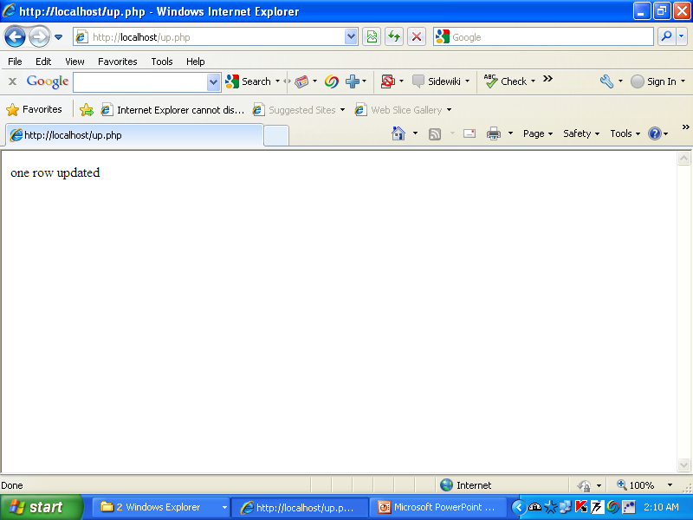
After updatation

Slide 23
Major Advantages
No browser compatibility issues
Access to server –side resources
Reduced load on the receiver

Slide 24
THE END

